Slide 1
Credit Risk Assessment in Fintech Industry
Solution to do EDA and Preprocessing on the train data using pipeline and training a model

Slide 2
Credit Risk Assessment in Fintech Industry
Problem Statement:
Welcome to Inceptez hackathon – Credit Risk in Fintech Industry. You are required to build and train a model that identifies Fully Paid and Charged-off loans from the loan dataset. This dataset is included in loan data, and provides a challenging classifier that will test what you have learnt in this course.

Slide 3
Tasks to comple EDA, preprocessing and model building
This data set is a highly imbalanced one.
Over 80% of the data points to “fully paid” customers and the remaining pertains to “Charged Off” customers.
There were about 27 independent variables and 1 dependent variabe (target variable).
Many of the variables were having noise in the data like “fico_range_high” and “fico_range_low”

Slide 4
“grade” column needs slicing to filter just the number out . We have to change the dtype from object to int.
“earliest_cr_line” feature has date and year in them. Used to_date time to extract the total number of year between the current year and mentioned year.
“emp_length” featured turned out be a noisy one so I have deleted it.
Same thing with “grade”,” fico_range_low”,” title”,” emp_title”,” pub_rec_bankruptcies”. So, we can delete all those columns.
Created 4 custom tranformers to impute data on columns with null values.

Slide 5
Used matplotlib and seaborn to visualize the data for better understanding of the data.
Used pipeline to preprocess my data and scale the data.
Used Random forest, logistic regression and decision tree to predict the classification for my test data.
A more detailed explanation can be found on the jupyter notebook file.

Slide 6
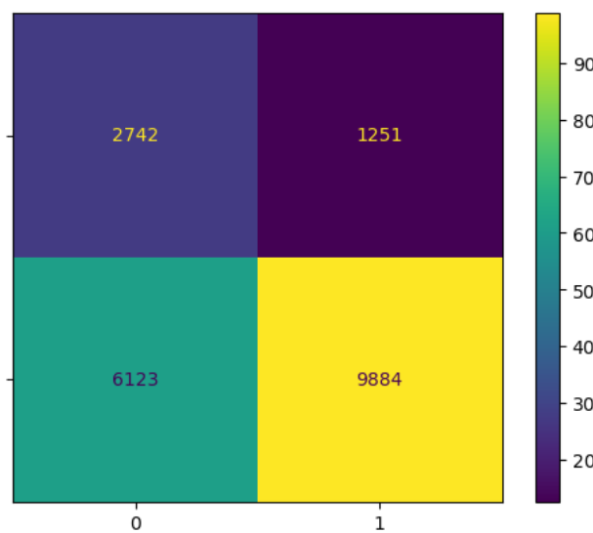
Result for logistic regression

Slide 7
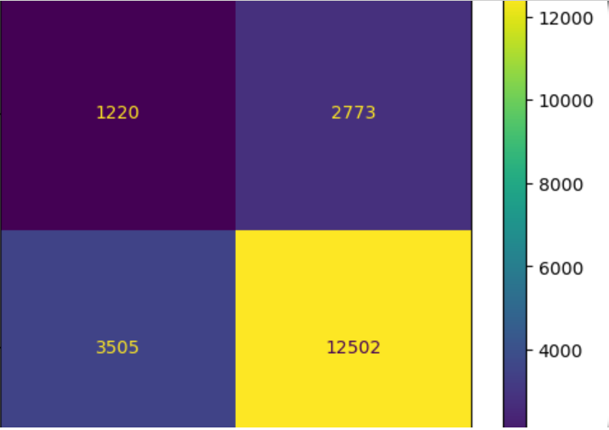
Result for Decision Tree

Slide 8
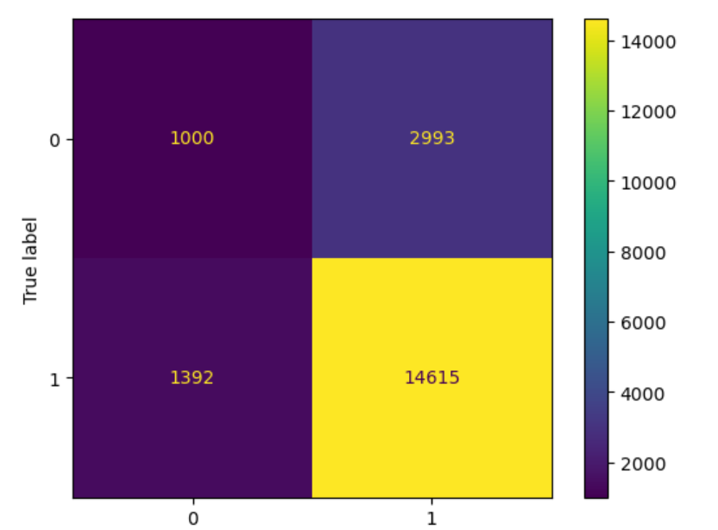
Result for RF Classifier with out hyper parameter tuning

Slide 9
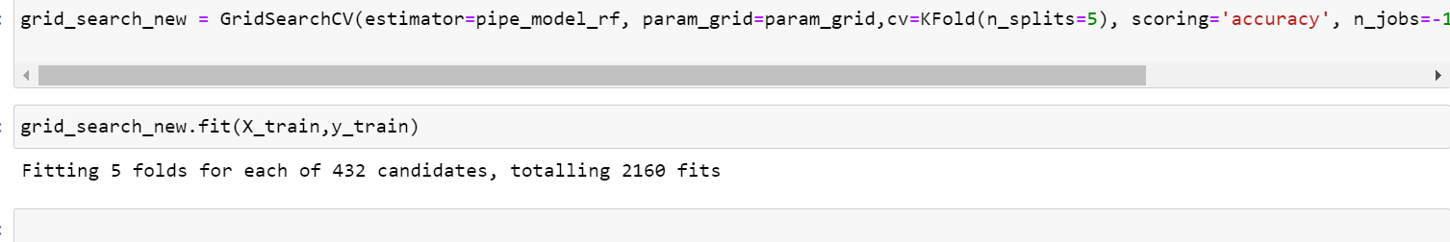
Waiitng for the last 1.5 hours to get a result from GridSearchCV.

